Slide 1
CYB 110 CYBERSECURITY AND PRIVACY MODULE 9 - PHYSICAL SECURITY JIM ALVES-FOSS AND JIA SONG

Slide 2
PHYSICAL SECURITY
Physical security - A set of security measures that we put in place to protect our people, equipment, and facilities.
Physical security is the protection of physical items, objects or areas from unauthorized access and misuse.
Physical security involves the protection of three main categories of assets:
People
Equipment
Data

Slide 3
PLANNING
Many larger organizations protect their assets by implementing policies and procedures:
Business continuity planning (BCP)
Limit risk and get an organization running as close to normal as possible in a state of emergency.
Disaster recovery planning (DRP)
Prepare for a potential disaster, including what exactly to do during and after a disaster strikes.

Slide 4
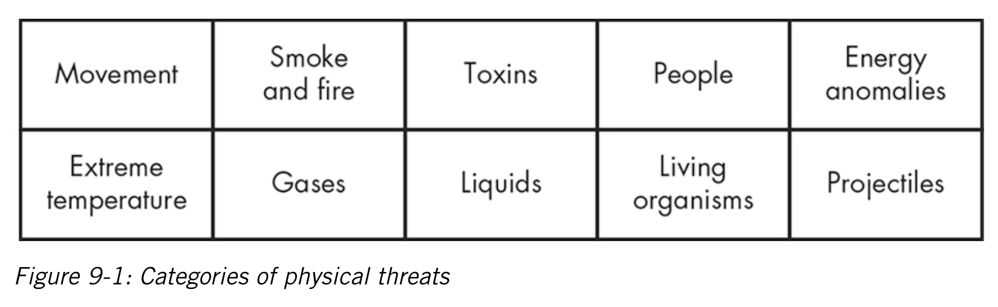
IDENTIFYING PHYSICAL THREATS
Physical security threats generally fall into these categories

Slide 5
MAJOR SOURCES OF PHYSICAL THREATS
Extreme temperature - extreme heat or cold
Gases – includes humidity or dry air, gases, suspended particles
Liquids – includes water, chemicals
Living organisms – viruses, bacteria, animals, insects
Projectiles -- powered objects
Movement – shaking, collapse, slide, vibrating
Energy anomalies - electrical surge, static electricity, radiation
People
Toxins
Smoke and fire

Slide 6
PHYSICAL SECURITY CONTROLS
Physical security controls are the devices, systems, people, and methods you put in place to ensure your physical security.
There are three main types of physical controls:
Deterrent controls - discourage people from violating the security controls.
Detective controls - sense and report undesirable events.
Preventive controls - physical means to keep unauthorized entities from breaching your physical security.

Slide 7
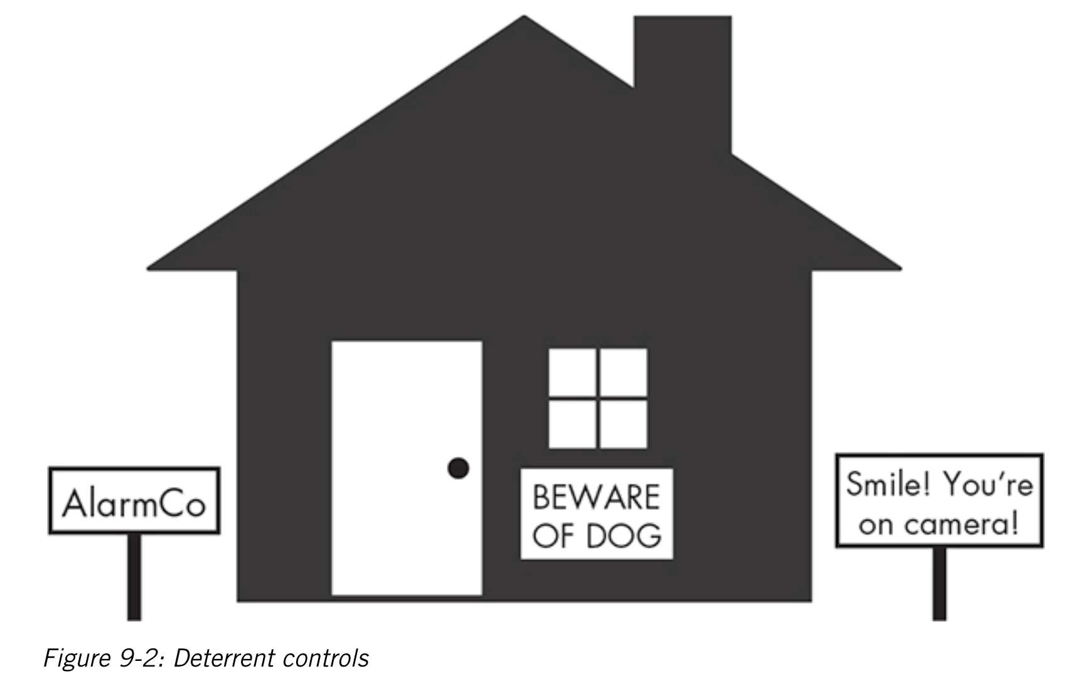
We want to protect a house. What can we do?
Deterrent control?
Detective controls? Preventive controls?

Slide 8
DETERRENT CONTROLS
Deterrent controls - discourage people from violating the security controls.
These controls do not prevent people from acting in an undesirable fashion.

Slide 9
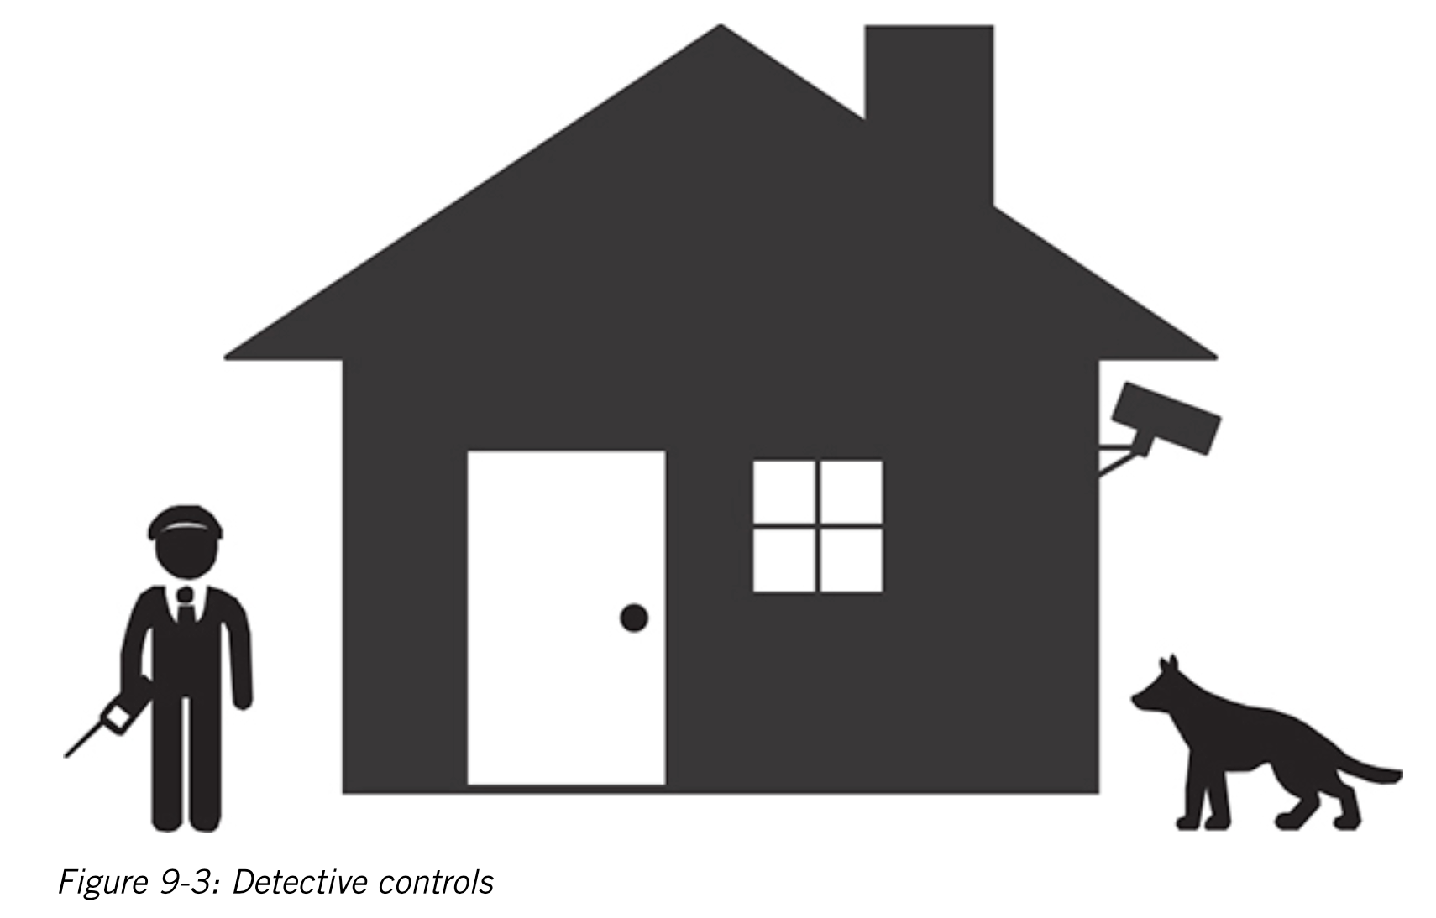
DETECTIVE CONTROLS
Detective controls - sense and report undesirable events.
These systems typically check for indicators of unauthorized activities.

Slide 10
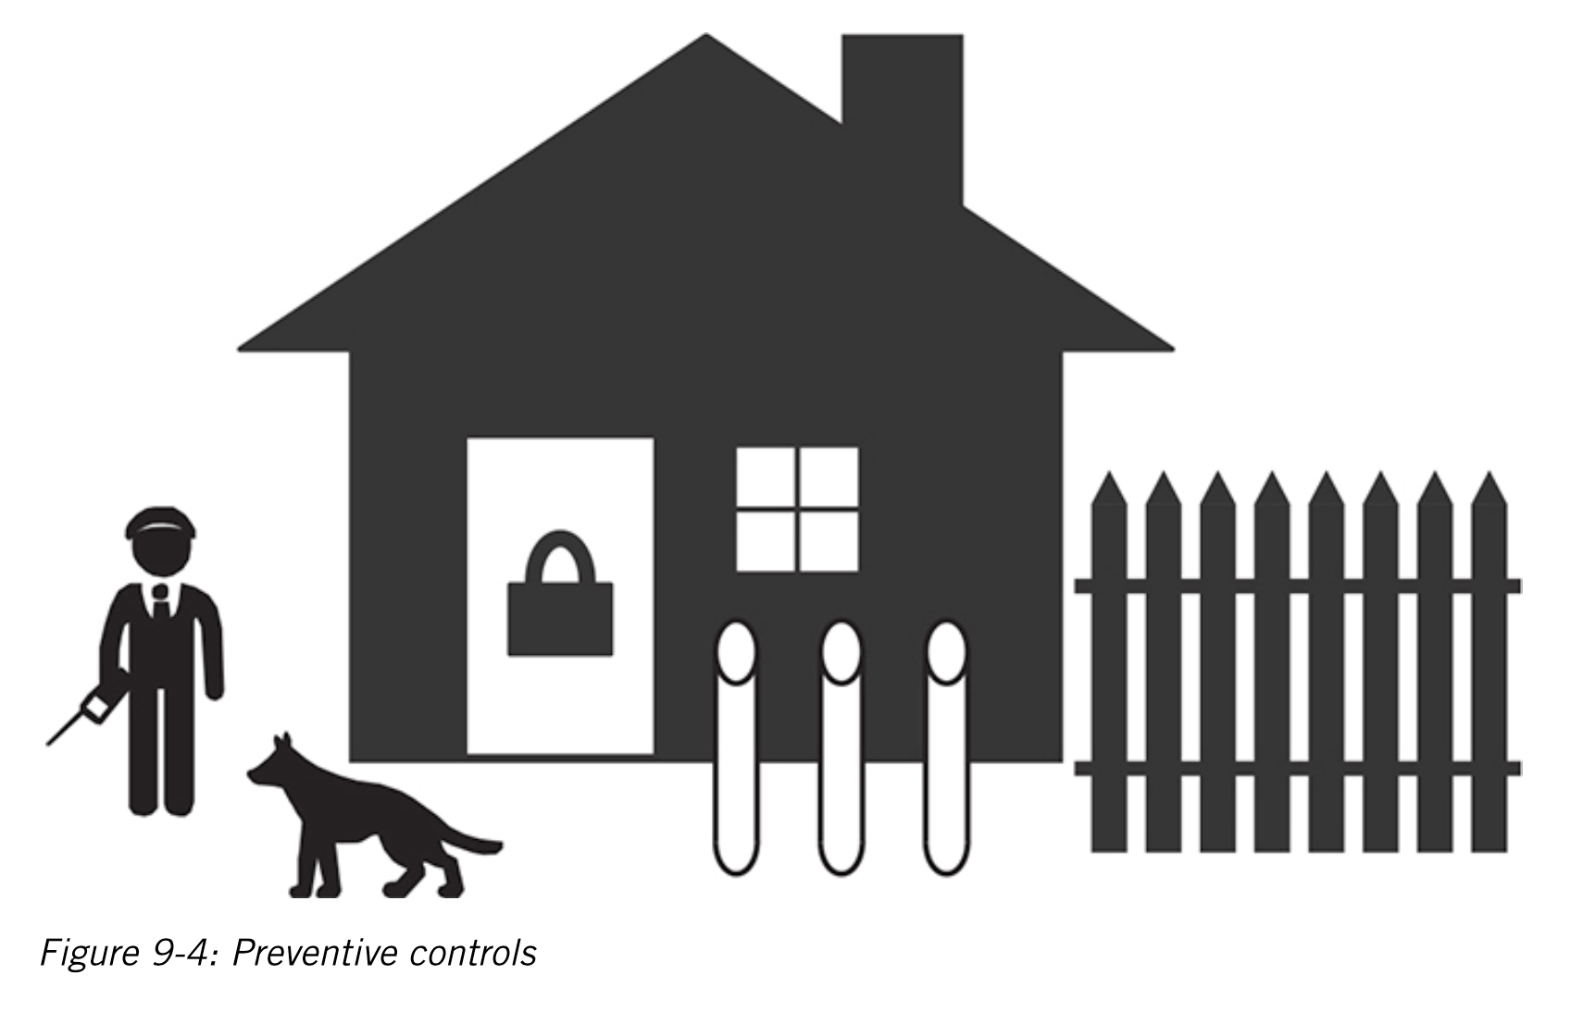
PREVENTIVE CONTROLS
Preventive controls - physical means to keep unauthorized entities from breaching your physical security.
Notes:
In commercial facilities, you are much more likely to see all three types of controls implemented. Locks, alarm systems, and signs indicating the presence of the alarm systems.

Slide 11
PHYSICAL SECURITY
Physical security - A set of security measures that we put in place to protect our people, equipment, and facilities.
Physical security involves the protection of three main categories of assets:
People
Equipment
Data
The primary goal of physical security is to protect the individuals/people.

Slide 12
PROTECTING PEOPLE
Physical concerns for people:
Extreme temperatures
Living organisms (from larger animals to nearly invisible mods, fungi...)
Significant movement (earthquake, mudslide ...)
Other people (physically attack somebody)
Smoke and fire
...

Slide 13
EVACUATION
During an emergency, you should prioritize evacuating people from the facility, not saving the equipment.
Planning evacuation procedure is one of the best ways to keep people safe.
Where - know where you will be evacuating to?
How - the route you will follow
Who - ensure everyone has left the building

Slide 14
PROTECTING DATA
Encryption can be used to protect data.
We need to keep the physical storage media safe against attackers, unfavorable environmental conditions, and other threats.
Physical concerns for data:
Magnetic media - strong magnetic fields can harm hard drives, tapes, floppy disks.
Optical media, CDs and DVDs, is fragile.
Accessibility of Data - Preserve sensitive data by maintaining copies in physically separated locations.

Slide 15
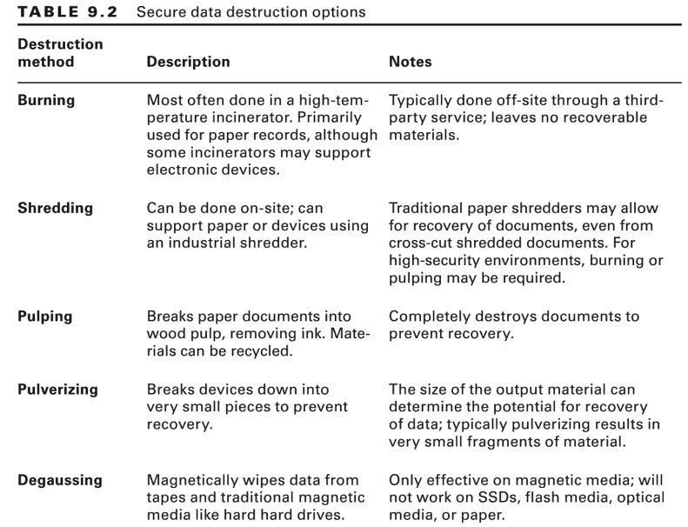
SECURE DATA DESTRUCTION
When data reaches the end of its lifespan, destroying the media that contains it is an important physical security measure.

Slide 16
PROTECTING EQUIPMENT
Protect your equipment and the facilities that house it.
Physical concerns for equipment:
Extreme temperatures
Liquids
Living organisms (chew on wiring...)
Movement
Energy anomalies (loss of power, electrical surge...)
Smoke and fire (may introduce extreme temperatures)
Notes:
This category falls last on the list because it represents the easiest and cheapest segment of assets to replace.
In the environments that contain large # of computers and equipment, we rely on environmental conditioning equipment to keep the temperature down to a reasonable level.
Electronics don’t function well when wet, generally. In case of flooding, equipment will become completely unusable.

Slide 17
PROTECTING FACILITIES
Site selection - when planning a new facility
Secure facility: physical location with controls designed to minimize risk of physical attacks.
Design considerations: Natural terrain, traffic flow, security landscaping ...
Securing access to equipment or facilities
Proper level of security inside and outside the facility.
Defense in depth
Other measures: Fences, gates, walls, alarms, monitoring system, guards, doors, locks...
Notes:
facility may be completely unusable or destroyed.

Slide 18
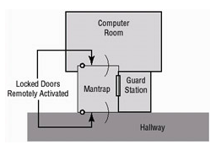
EXAMPLE: MANTRAP DOOR SYSTEM
Mantraps require visual identification, as well as authentication, to gain access.
One person enters mantrap via unlocked door.
Person’s identity is verified by the guard.
If authorized, person allowed to enter the computer room; otherwise, person cannot leave the mantrap unless released by the guard.
Source: https://flylib.com/books/en/4.213.1.70/1/

Slide 19
ALARMS AND ALARM SYSTEMS
Alarm systems notify organization when “events” occur.
Systems rely on sensors for event detection:
Motion detectors
Smoke detectors
Thermal detectors
Glass breakage detectors
Weight/contact sensors

Slide 20
ELECTRONIC MONITORING
Records events where other types of physical controls are impractical.
May use cameras with video recorders.
Drawbacks:
Reactive; does not prevent access to facility (or property damage)
Recordings often not monitored in real time, must be reviewed to have any value.
Motion recognition cameras activate when motion occurs.

Slide 21
PROTECTING EQUIPMENT
Environmental conditions
Maintain proper environmental conditions (temperature, humidity, power)
Add in power filtering and generators
Control the temperature

Slide 22
SUMMARY
Physical security - A set of security measures that we put in place to protect our people, equipment, and facilities.
Physical security is the protection of physical items, objects or areas from unauthorized access and misuse.
Physical security involves the protection of three main categories of assets:
People
Equipment
Data

Slide 23
PLEASE ATTRIBUTE DR. JIM ALVES-FOSS AND DR. JIA SONG, UNIVERSITY OF IDAHO EXCEPT WHERE OTHERWISE NOTED, THIS WORK IS LICENSED UNDER HTTPS://CREATIVECOMMONS.ORG/LICENSES/BY-NC-SA/4.0/ NOT WITHSTANDING THE NON-COMMERCIAL LICENSE TERMS, NON-PROFIT EDUCATIONAL INSTITUTIONS ARE GRANTED A NON-EXCLUSIVE LICENSE TO ADAPT AND USE THIS MATERIAL, WITH ATTRIBUTION. CREATIVE COMMONS AND THE DOUBLE C IN A CIRCLE ARE REGISTERED TRADEMARKS OF CREATIVE COMMONS IN THE UNITED STATES AND OTHER COUNTRIES. THIRD PARTY MARKS AND BRANDS ARE THE PROPERTY OF THEIR RESPECTIVE HOLDERS.

